Slide 1
EE 5301 – VLSI Design Automation I
Part VI: Routing
Kia Bazargan
University of Minnesota

Slide 2
References and Copyright
Textbooks referred (none required)
  [Mic94] G. De Micheli
  “Synthesis and Optimization of Digital Circuits”
  McGraw-Hill, 1994.
  [CLR90] T. H. Cormen, C. E. Leiserson, R. L. Rivest
  “Introduction to Algorithms”
  MIT Press, 1990.
  [Sar96] M. Sarrafzadeh, C. K. Wong
  “An Introduction to VLSI Physical Design”
  McGraw-Hill, 1996.
  [She99] N. Sherwani
  “Algorithms For VLSI Physical Design Automation”
  Kluwer Academic Publishers, 3rd edition, 1999.

Slide 3
References and Copyright (cont.)
Slides used: (Modified by Kia when necessary)
  [©Sarrafzadeh] © Majid Sarrafzadeh, 2001;
  Department of Computer Science, UCLA
  [©Sherwani] © Naveed A. Sherwani, 1992
  (companion slides to [She99])
  [©Keutzer] © Kurt Keutzer, Dept. of EECS,
  UC-Berekeley
  http://www-cad.eecs.berkeley.edu/~niraj/ee244/index.htm
  [©Gupta] © Rajesh Gupta
  UC-Irvine
  http://www.ics.uci.edu/~rgupta/ics280.html
  [©Kang] © Steve Kang
  UIUC
  http://www.ece.uiuc.edu/ece482/

Slide 4
Routing
Problem
  Given a placement, and a fixed number of metal layers, find a valid pattern of horizontal and vertical wires that connect the terminals of the nets
  Levels of abstraction:
    Global routing
    Detailed routing
Objectives
  Cost components:
    Area (channel width) – min congestion in prev levels helped
    Wire delays – timing minimization in previous levels
    Number of layers (less layers → less expensive)
    Additional cost components: number of bends, vias

Slide 5
Routing Anatomy
3D
view
Top
view
Symbolic
Layout
Metal layer 3
Via
Note: Colors used
in this slide are not
standard
Metal layer 2
Metal layer 1
Notes:
Top layers have more spacing between wires
Top layers higher aspect ratio (like walls)

Slide 6
Global vs. Detailed Routing
Global routing
  Input: detailed placement, with exact terminal locations
  Determine “channel” (routing region) for each net
  Objective: minimize area (congestion), and timing (approximate)
Detailed routing
  Input: channels and approximate routing from the global routing phase
  Determine the exact route and layers for each net
  Objective: valid routing, minimize area (congestion), meet timing constraints
  Additional objectives: min via, power
Figs. [©Sherwani]

Slide 7
Routing Environment
Routing regions
  Channel
    Fixed height ?
    (→ fixed number of tracks)
    Fixed terminals on top and bottom
    More constrained problem: switchbox.
    Terminals on four sides fixed
  Area routing
    Wires can pass through any region not occupied by cells
    (exception: over-the-cell routing)
Routing layers
  Could be pre-assigned (e.g., M1 horizontal, M2 vert.)
  Different weights might be assigned to layers
1
1
4
5
4
1,3
4,5
3
2
2
3
5

Slide 8
Routing Environment
Chip architecture
  Full-custom:
    No constraint on routing regions
  Standard cell:
    Variable channel height?
    Feed-through cells connect channels
  FPGA:
    Fixed channel height
    Limited switchbox connections
    Prefabricated wire segments have different weights
Feedthroughs
Channel
Failed net
Tracks
Failed connection
Figs. [©Sherwani]

Slide 9
Taxonomy of VLSI Routers
Routers
Global
Detailed
Specialized
Graph Search
General Purpose
Power/Gnd
Restricted
Steiner
Clock
River
Maze
Iterative
Switchbox
Line Probe
Maze
Channel
Line Expansion
Hierarchical
Greedy
Left-Edge
[©Keutzer]

Slide 10
Global Routing
[©Sarrafzadeh]
Stages
  Routing region definition
  Routing region ordering
  Steiner-tree / area routing
Grid
  Tiles super-imposed on placement
  Regular or irregular
  Smaller problem to solve,
  higher level of abstraction
  Terminals at center of grid tiles
Edge capacity
  Number of nets that can pass a certain grid edge (aka congestion)
  On edge E_{ij},
  Capacity(E_{ij}) ≥ Congestion(E_{ij})
M1
M2
M3

Slide 11
Grid Graph
Course or fine-grain
Vertices: routing regions, edges: route exists?
Weights on edges
  How costly is to use that edge
  Could vary during the routing (e.g., for congestion)
  Horizontal / vertical might have different weights
t1
t2
t3
t1
t2
t3
t4
t4
1
1
1
t1
t2
t3
2
2
1
1
t4
1
1
1
[©Sherwani]
Notes:
The weight on the edges in the middle graph indicate edge cost, not capacity.
The right graph is called “channel intersection” graph. It is more popular than the other two.

Slide 12
Global Routing – Graph Search
Good for two-terminal nets
Build grid graph (Coarse? Fine?)
Use graph search algorithms, e.g., Dijkstra
Iterative: route nets one by one
How to handle:
  Congestion?
  Critical nets?
Order of the nets to route?
  Net criticality
  Half-perimeter of the bounding box
  Number of terminals

Slide 13
Global Routing – Maze Routing
Similar to breadth-first search
  Very simple algorithm
  Works on grid graph
  Time complexity: grid size (NxN)
Algorithm
  Propagate a “wave” from source
  until hit the sink
  (implemented using a queue)
  Trace back to find the path
Guaranteed to find the optimal solution
  Usually multiple optimal solutions exist
More than two terminals?
  For the third terminal, use the path between the first two as the source of the wave
5
5
4
5
4
3
5
t
4
5
3
2
3
4
5
2
1
s
1
2
3
4
5
3
2
1
2
3
4
5

Slide 14
Maze Routing
Key to popularity:
  Simplicity
  Guaranteed to find the optimal solution
  Can realize more complex cost functions too
  (e.g., number of bends in a path)
Weakness:
  Multiple terminals not handled efficiently
  Dependent on grid, a two dimensional data structure
Different variations exist
  Soukup’s alg:
    First use DFS, when get to an obstacle, use BFS to get around
    No guarantee to find the shortest path

Slide 15
Multiple Terminal Nets: Steiner Tree
Steiner tree (aka Rectilinear Steiner Tree – RST):
  A tree connecting multiple terminals
    Original points: “demand points” – set D
    Added points: “Steiner points” – set S
  Edges horizontal or vertical only
Steiner Minimum Tree (SMT)
  Similar to minimum spanning tree (MST)
  But finding SMT is NP-complete
  Many good heuristics introduced to find SMT
Algorithm
  Find MST
  Pass horizontal and vertical lines from each terminal to get the Hannan grid (optimal solution is on this grid)
  Convert each edge of the MST to an L-shaped route
  on Hannan grid (add a Steiner point at the corner of L)

Slide 16
Steiner Tree
Hannan grid reduces solution space (smaller grid)
  For min length RST, Steiner points always on Hannan grid
Convert MST to rectilinear paths
  Length bounded by 1.5 times optimal SMT length
Use alternate “L” routes to find the minimum tree
Steiner
point
MSP (length=11)
Steiner tree (len=13)
[©Sherwani]
Notes:
Is the Steiner tree shown on the right the optimum?

Slide 17
Steiner Tree Routing
Can apply different costs to different regions
(or horizontal/vertical preference)
Order of the nets
  Sequential
    Use # of terminals, criticality, etc. to determine order
  Parallel
    Divide the chip into large regions, perform the routing in parallel
Key to popularity
  Fast (not theoretically, but practically)
  Bounded solution quality
Shortcomings
  Difficult to predict or avoid congestion

Slide 18
Global Routing Approaches
A combination of different approaches
might be used in chip-level routing
  Route simple nets (2-3 pins in local area) directly
  (e.g., L-shaped or Z-shaped)
  Use a “close to optimal” Steiner Tree algorithms to route nets of intermediate length
  Route remaining “big” nets using a maze router
Ordering
  Some ordering is chosen, if can route all, then done,
  otherwise:
  Rip-up and Re-route
[©Keutzer]

Slide 19
Taxonomy of VLSI Routers
Routers
Global
Detailed
Specialized
Graph Search
General Purpose
Power/Gnd
Restricted
Steiner
Clock
River
Maze
Iterative
Switchbox
Line Probe
Maze
Channel
Line Expansion
Hierarchical
Greedy
Left-Edge
[©Keutzer]

Slide 20
Detailed Routing: Channel vs. Switchbox
Channels have no conflicts
Conflicting channels
Conflict resolved using L-shaped channels
  Order matters
Switchbox used to resolve the conflict
  Order matters
  Harder problem (compared to channel routing)
Switch-
box
1
3
3
1
1
4
2
2
2
2
1
(c)
(d)
(a)
(b)
[©Sherwani]

Slide 21
Channel Routing Problem
Input
  Fixed terminal locations on the top and bottom
  Possibly floating terminals on the left and right
  Possibly fixed channel capacity constraint
  (capacity = max # of horizontal wires between the top and bottom boundaries of the channel)
  Either gridless (aka area-based) or grid-based
In the algorithms we consider
  Constraints:
    Grid structure
    Two routing layers (one for H, another for V)
    Still relevant?
  Minimize
    # tracks (channel height)
    Total wire length
    # vias
Grid-based
Gridless
[©Sherwani]
[©Keutzer]

Slide 22
Channel Routing Algorithms and Terminology
General case is NP-Complete
Algorithms
  Simple case: left-edge algorithm (P)
  General case: NP ➔ heuristics
    Problem defined using horizontal constraints graph
    and vertical constraints graph
    Either graph-based algorithms or
    greedy algorithms are used
Terminology
nets
2
2
branch
1
1
via
tracks
trunk
pins
2
1
[©Keutzer]

Slide 23
Channel Routing Example
Problem instance:
Solution:
1
4
5
1
6
7
4
9
10
10
2
3
5
3
5
2
6
8
9
8
7
9
1
4
5
1
6
7
4
9
10
10
2
3
5
3
5
2
6
8
9
8
7
9
[©Keutzer]

Slide 24
Vertical Constraint Graph
Represents the relative vertical positions of different net trunks (tracks)
  Node: represents a net
  Edge (x, y): if at the same column,
  x has a terminal on the upper edge and
  y has a terminal on the lower edge
  (a,b) means that net “a” has to be
  above “b” – why?
Lower bound:
  # tracks ≥ longest path in VCG
VCG may have a cycle!
  What shall we do??
1
4
5
2
3
5
3
2
1
4
3
5
b
a
?
a
b
a
b

Slide 25
Horizontal / Vertical Constraint Graphs
Channel routing problem can be completely characterized by VCG and HCG
1
4
5
1
6
7
4
9
10
10
2
3
5
3
5
2
6
8
9
8
7
9
1
4
10
1
3
2
5
9
7
5
6
4
6
7
3
8
8
2
9
10
Vertical constraint graph (VCG)
Horizontal constraint graph (HCG)
[©Keutzer]

Slide 26
Channel Density
A net extends from its leftmost
terminal to its rightmost one
Local density at column C
  ld (C) = # nets split by column C
Channel density
  d = max ld(c) over all C
Relationship to HCG?
  Local density ⬄ clique in HCG
  d ⬄ size of maximum clique in HCG
Lower bound:
  # tracks ≥ d
1
4
5
1
6
7
2
3
5
3
5
2
6
8
1
3
2
5
6
4
7
8
[©Keutzer]

Slide 27
Left-edge Channel Routing Algorithm
Used when no VCG edges
Finds the optimal solution (# tracks = d)
Nets are sorted according to their left endpoints
Algorithm:
  Create an initial track t
  For all nets n_{i} in the order of their left endpoints
  if feasible to place the net on an existing track t_{j},
  assign net n_{i} to track t_{j}.
  else create a new track t_{new} and assign n_{i} to it.
Time complexity: O(n log n)

Slide 28
Doglegs
Doglegs can reduce the longest path in VCG
Doglegs break cycles in VCG
a
a
b
c
a
a
a
b
c
a
c2
c2
b
c1
b
d
c
a
b
c
d
d
c1
a
b
c
d
d
d
b
a
b
a
b1
a
b1
?
a
b2
b
a
b
a
b
b2
[©Keutzer]

Slide 29
Greedy Channel Router
Many greedy algorithms for channel routing exist
Example: Rivest and Fiduccia DAC’82
  Simple, linear algorithm
  Guarantees routing of all nets
  Uses doglegs (both restricted and unrestricted)
  BUT may extend to right hand side of the channel
Other techniques
  Hierarchical: divide the channel into two smaller channels, route each small channel, merge
  VCG reduction: nets that can be placed on the same track merged into one VCG node to reduce VCG size

Slide 30
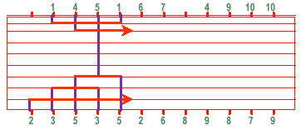
Greedy Router: Rivest and Fiduccia
Proceed column by column (left to right)
Make connections to all pins in that column
Free up tracks by collapsing as many tracks as possible to collapse nets
Shrink range of rows occupied by a net by using doglegs
If a pin cannot enter a channel, add a track
O(pins) time
[©Keutzer]

Slide 31
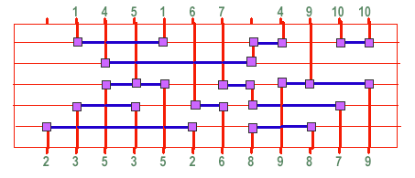
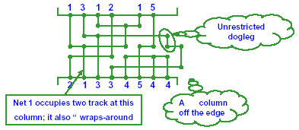
Rivest and Fiduccia: Example
Example output:
Observations:
  Always succeeds
  (even if cyclic conflict is present)
  Allows unrestricted doglegs
  Allows a net to occupy more than 1 track at a given column
  May use a few columns off the edge
[©Keutzer]

Slide 32
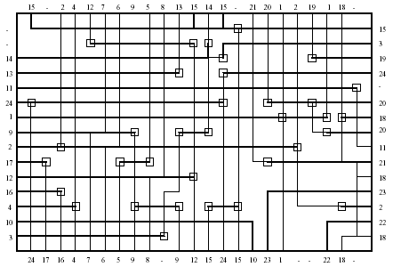
Switchbox Routing
Much harder problem than channel routing
  Two-dimensional problem
  (channel routing was in a way one dimensional)
  Need to solve in a hierarchical flow
  (split a channel
  into two, route one
  first, and route the
  second as a
  switchbox)
A number of
complex heuristic
algorithms exist
[©Sarrafzadeh]

Slide 33
FPGA Architecture - Layout
Island FPGAs
  Array of functional units
  Horizontal and vertical routing channels connecting the functional units
  Versatile switch boxes
  Example: Xilinx, Altera
Row-based FPGAs
  Like standard cell design
  Rows of logic blocks
  Routing channels (fixed width) between rows of logic
  Example: Actel FPGAs

Slide 34
FPGA Programmable Switch Elements
Used in connecting:
  The I/O of functional units to the wires
  A horizontal wire to a vertical wire
  Two wire segments to form a longer wire segment

Slide 35
FPGA Routing Channels Architecture
Note: fixed channel widths (tracks)
Should “predict” all possible connectivity requirements when designing the FPGA chip
Channel -> track -> segment
Segment length?
  Long: carry the signal longer,
  less “concatenation” switches, but might waste track
  Short: local connections, slow for longer connections
segment
track
channel

Slide 36
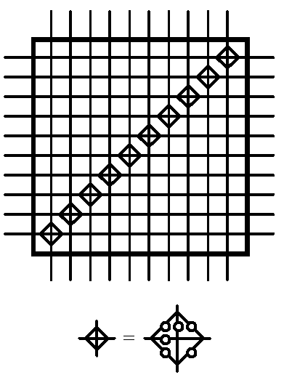
FPGA Switch Boxes
Ideally, provide switches for all possible connections
Trade-off:
  Too many switches:
    Large area
    Complex to program
  Too few switches:
    Cannot route signals
One possible
solution
Xilinx 4000

Slide 37
FPGA Routing
Routing resources pre-fabricated
  100% routability using existing channels
  If fail to route all nets, redo placement
FPGA architectural issues
  Careful balance between number of logic blocks and routing resources (100% logic area utilization?)
  Designing flexible switchboxes and channels
  (conflicts with high clock speeds)
FPGA routing algorithms
  Graph search algorithms
    Convert the wire segments to graph nodes, and switch elements to edges
  Bin packing heuristics (nets as objects, tracks as bins)
  Combination of maze routing and graph search algorithms

